Slide 1
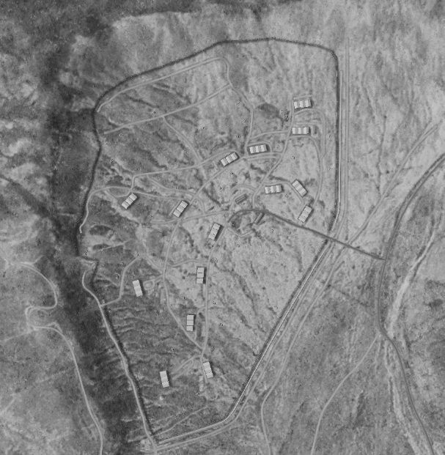
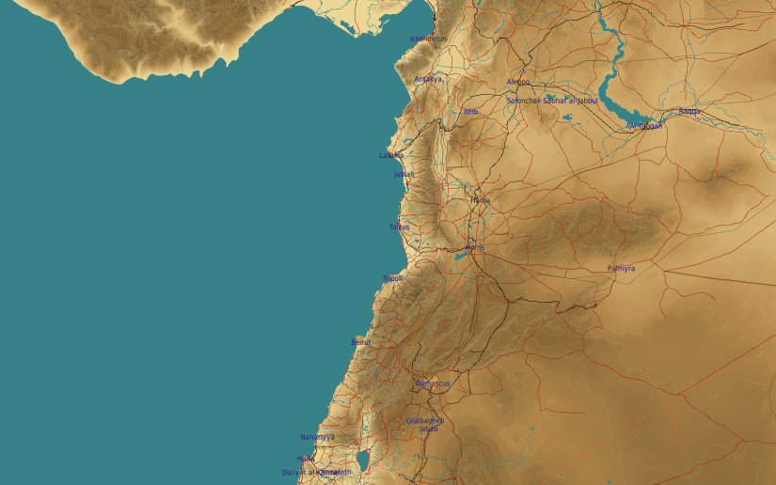
SYTGT079 Fifth Corps Base
N
SYTGT079
079
All buildings require the same amount of explosives to be destroyed, one of the following:
1x 2000 Ibs bomb
2x 1000 Ibs bombs
4x 500 Ibs bombs’
SYTGT079 A1-A3: Ordnance storage
SYTGT079 B1-B18: Vehicle storage
SYTGT079 C1-C3: Office buildings
SYTGT079 D1-D9: Fuel
SYTGT079 E: Ordnance storage
SYTGT079 F1-F2: Ordnance storage
SYTGT079 G1-G9:Maintenance buildings
The Corps have their living quarters for men and officers inside Palmyra city.
4
5
CDE Concern: Palmyra Castle (Fakhr-al-Din al-Ma'ani Castle) located 2.4 NMof SYTGT079. The Caste is a UNESCO World Heritige site and was built in the 13th Century
Closes civilian buildings are located 1,6 NM to the SOUTHEAST.
6
7
8

Slide 2
SYTGT079 A1-A3
N
SYTGT075 G1-G9
SYTGT079 C1-C6
SYTGT075 D1-D9
SYTGT079 B1-B18
SYTGT075 E
SYTGT075 F1-F2

